Slide 1
HEART RATE MEASUREMENT FROM FACIAL VIDEO
GUIDE:
DR.L. SAIRAMESH
Bhuvaneshwari P,
2019202008,
MCA-Regular.

Slide 2
MOTIVATION & OBJECTIVE
Traditional way of measurement of heart beat method could take lot of time consuming and in convincing of physical touching.
In pandemic situations like spread of virus, we might not wish to touch a patient to find the heart rate and doing electrocardiography.
So, if this happened remotely, we will be convenient to measure the heart rate i.e., blood volume pulse.
The objective is to create a Realtime application using computer vision for estimating heart rate from a facial video.

Slide 3
INTRODUCTION
Deep Learning is defined as an application of artificial intelligence to assist the processing of statistical data.
While Deep Learning involves concepts of automation, it requires human guidance.
Deep Learning involves a high level of generalization in order to get a system that performs well on yet unseen data instances.
Its significance is the ability to process large numbers of features makes deep learning very powerful when dealing with unstructured data.

Slide 4
LITERATURE REVIEW
S. No. | Author name & Paper title | Concept in the paper | Paper details
1. | Authors: H. Rahman, M.U. Ahmed, S. Begum, P. Funk Title: Real Time Heart Rate Monitoring From Facial RGB Color Video Using Webcam. | Fast Fourier Transform for signal analysis. Independent Components Analysis for separating a multivariate signal and Principal Component Analysis for estimation. | 9th Annual Workshop of the Swedish Artificial Intelligence Society (SAIS) 2016, Malmö, Sweden.
2. | Authors: P.V.P. Sai Kiran, Sujith Reddy Vangala, Mamoon Rashid. Title: Efficient Approach for Measuring Heart Pulse from Real Time Facial RGB Color Videos | Adaboost algorithm for feature selection. Fast Fourier Transform for signal analysis. Peak calculation for estimation. | 2021 2nd International Conference on Intelligent Engineering and Management.
3. | Authors: Carmen Nadrag, Vlad Poenaru and George Suciu. Title: Heart Rate Measurement Using Face Detection in Video | Haar Cascade for face detection. Adaboost algorithm for feature selection. Tracking algorithms are Boosting and Multiple Instance Learning tracker (MIL). | R&D Department, Beia Consult International, Bucharest, Romania, 2018.

Slide 5
FRAMEWORKS:
OpenMDAO:
OpenMDAO is an open-source framework for multidisciplinary design, analysis, and optimization. This is designed to aid in linking together separate pieces of software for the purpose of combined analyses.
Platforms:
Anaconda Navigator.
jupyter notebook
python IDLE
Library:
OpenCV :
OpenCV is a great tool for image processing and performing computer vision tasks. It is an open-source library that can be used to perform tasks like face detection, objection tracking, landmark detection, and much more. It supports multiple languages including python, java C++.

Slide 6
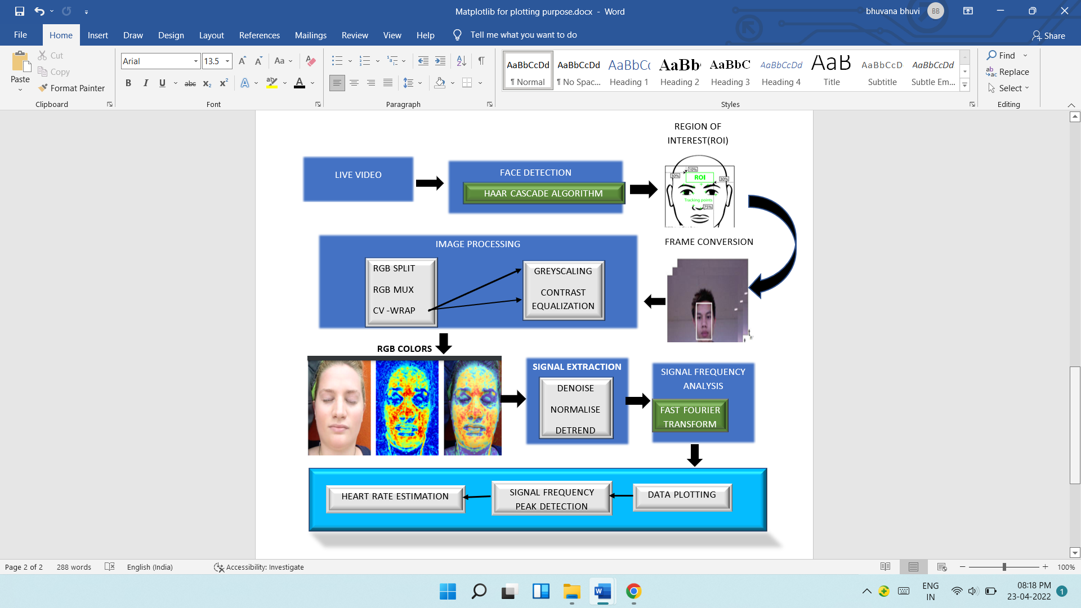
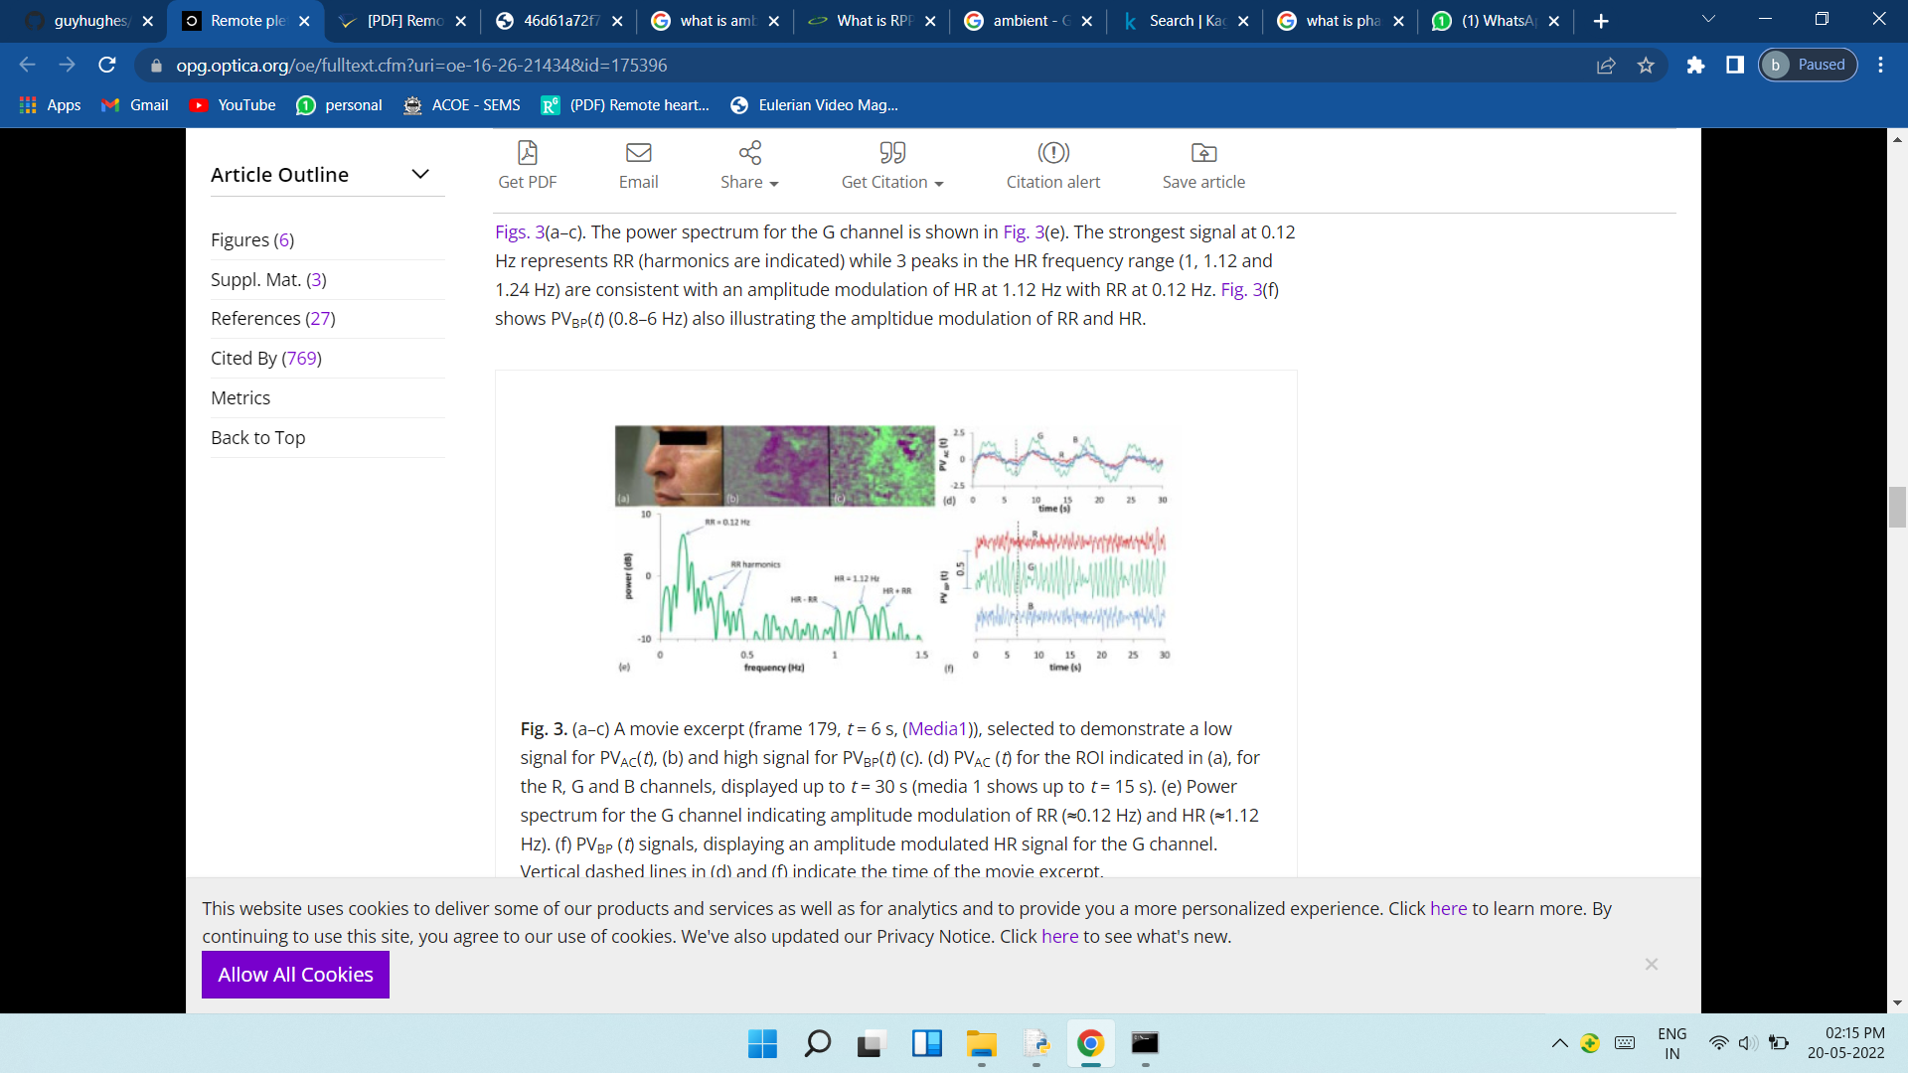
Architecture Diagram

Slide 7
LIST OF MODULES
Webcam
Face detection
ROI detection
Frame conversion
Image processing
RGB &HSV signal extraction
Data plotting
Heart Rate Measurement

Slide 8
MODULE DESCRIPTION
Camera: Get the live video from user and covert the video into frames.
Input: captured video, output: frames.
Image Processing: Whole-frame image processing components & helper methods
RGB split: Extract the red, green, and blue channels from an (n,m,3) shaped array representing a single image frame with RGB color coding.
RGB mux: Take three (m,n) matrices of equal size and combine them into a single RGB-coded color frame.
CV wrap: Generic wrapper to take the simpler functions from the cv2 or SciPy image libraries to generate connectable openMDAO components for image processing.

Slide 9
MODULES DESCRIPTION
Gray scale: Turn (m,n,3) shaped RGB image frame to a (m,n) frame. Discards color information to produce simple image matrix.
Equalise contrast: Automatic contrast correction for grayscale images.
Face Detection: Defect the face with haar cascade Algorithm.
ROI Detection: Defect the sub region in the face.
Signal Analysis: signal Frequency analysis with Fast Fourier Transform(FFT)
Data plotting: plot the obtained bpm in power spectral density and raw signal.
BPM plot: the estimated heart rate plotted in frame.

Slide 10
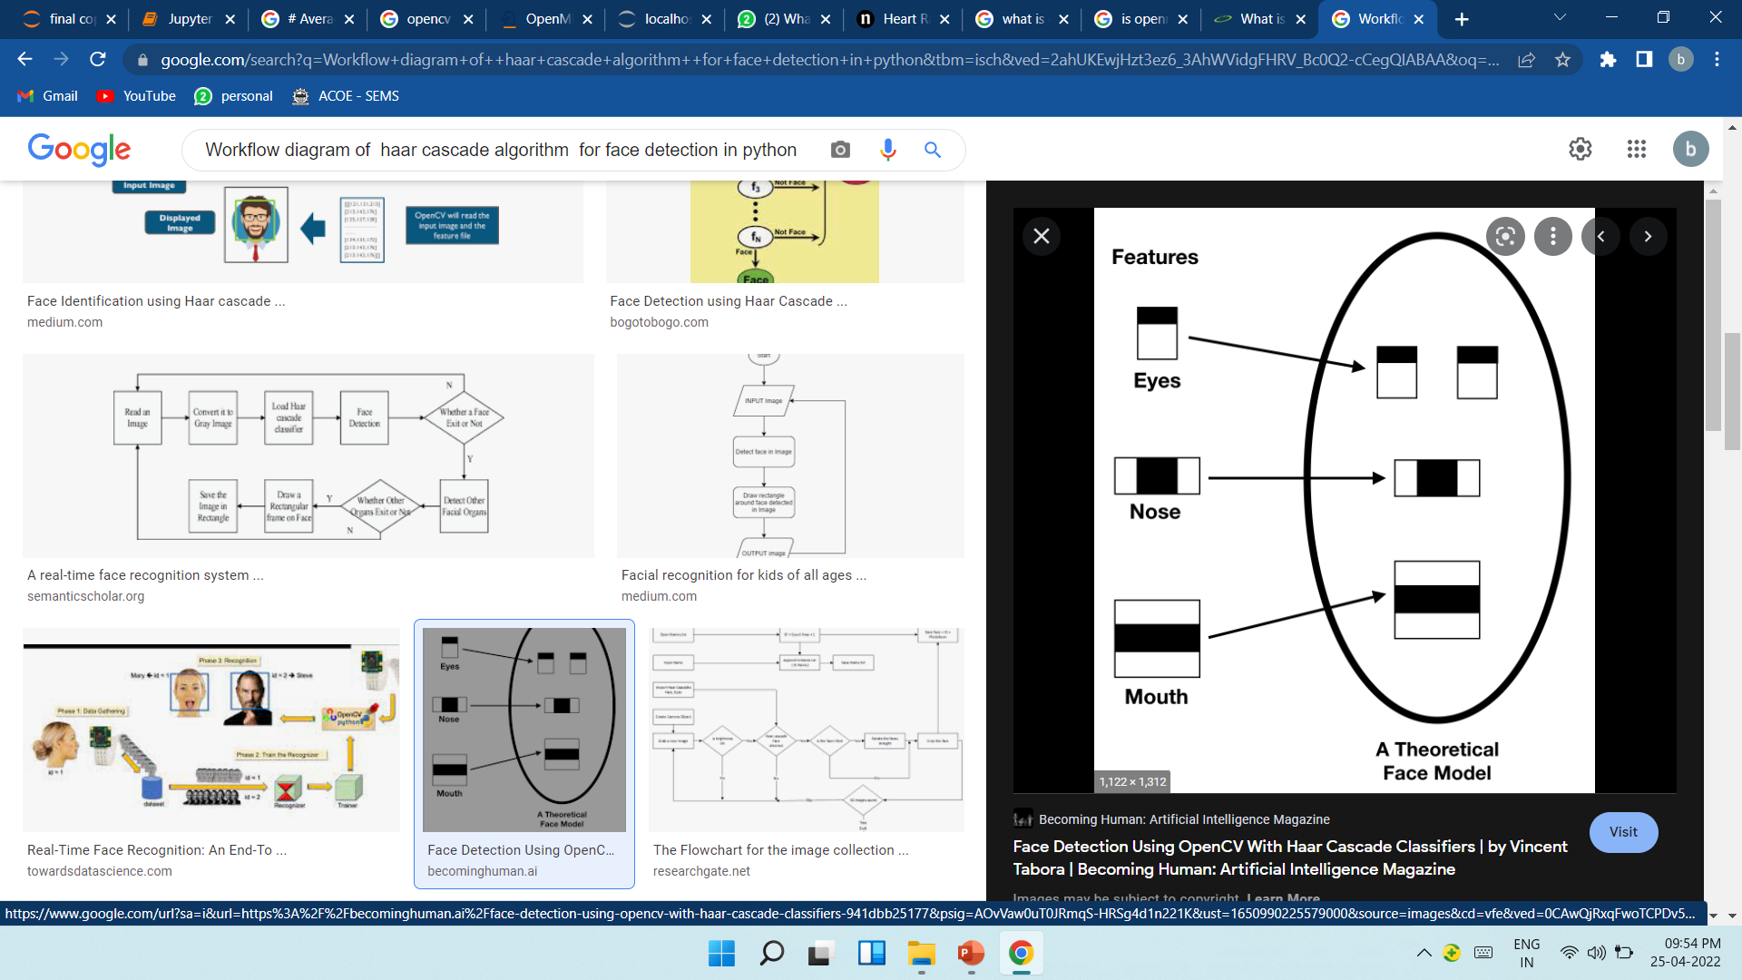
HAAR CASCADE ALGORITHM
Step 1: Loading the image
Step 2: Converting the image to grayscale
Step 3: Loading the required haar-cascade XML classifier file
Step 4: Applying the face detection method on the grayscale image

Slide 11
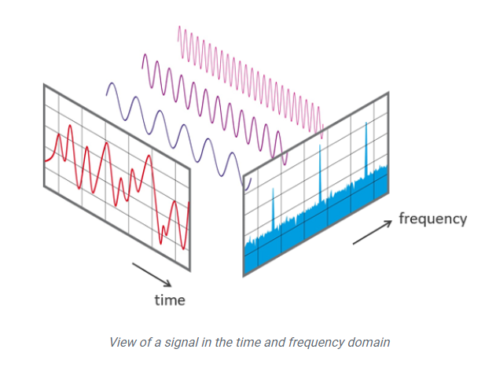
FAST FOURIER TRANSFORM
The component signals were fast Fourier transformed.
An FFT converts the component signals into an estimation of power spectra (squared magnitude) .
A high peak in power at a certain frequency means that the component was made up mostly of a sine-wave at that specific frequency.
This frequency is in most cases a reflection of the detected heart rate.

Slide 12
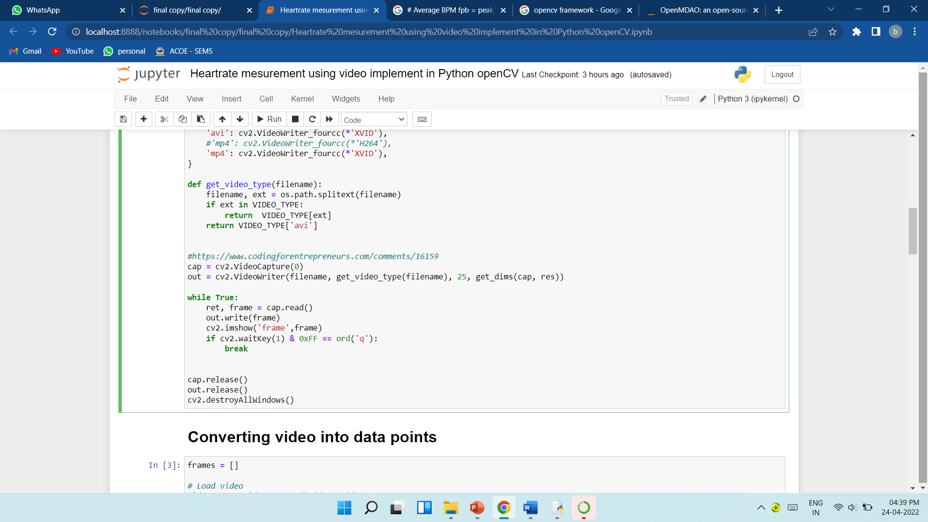

Video recording

Slide 13
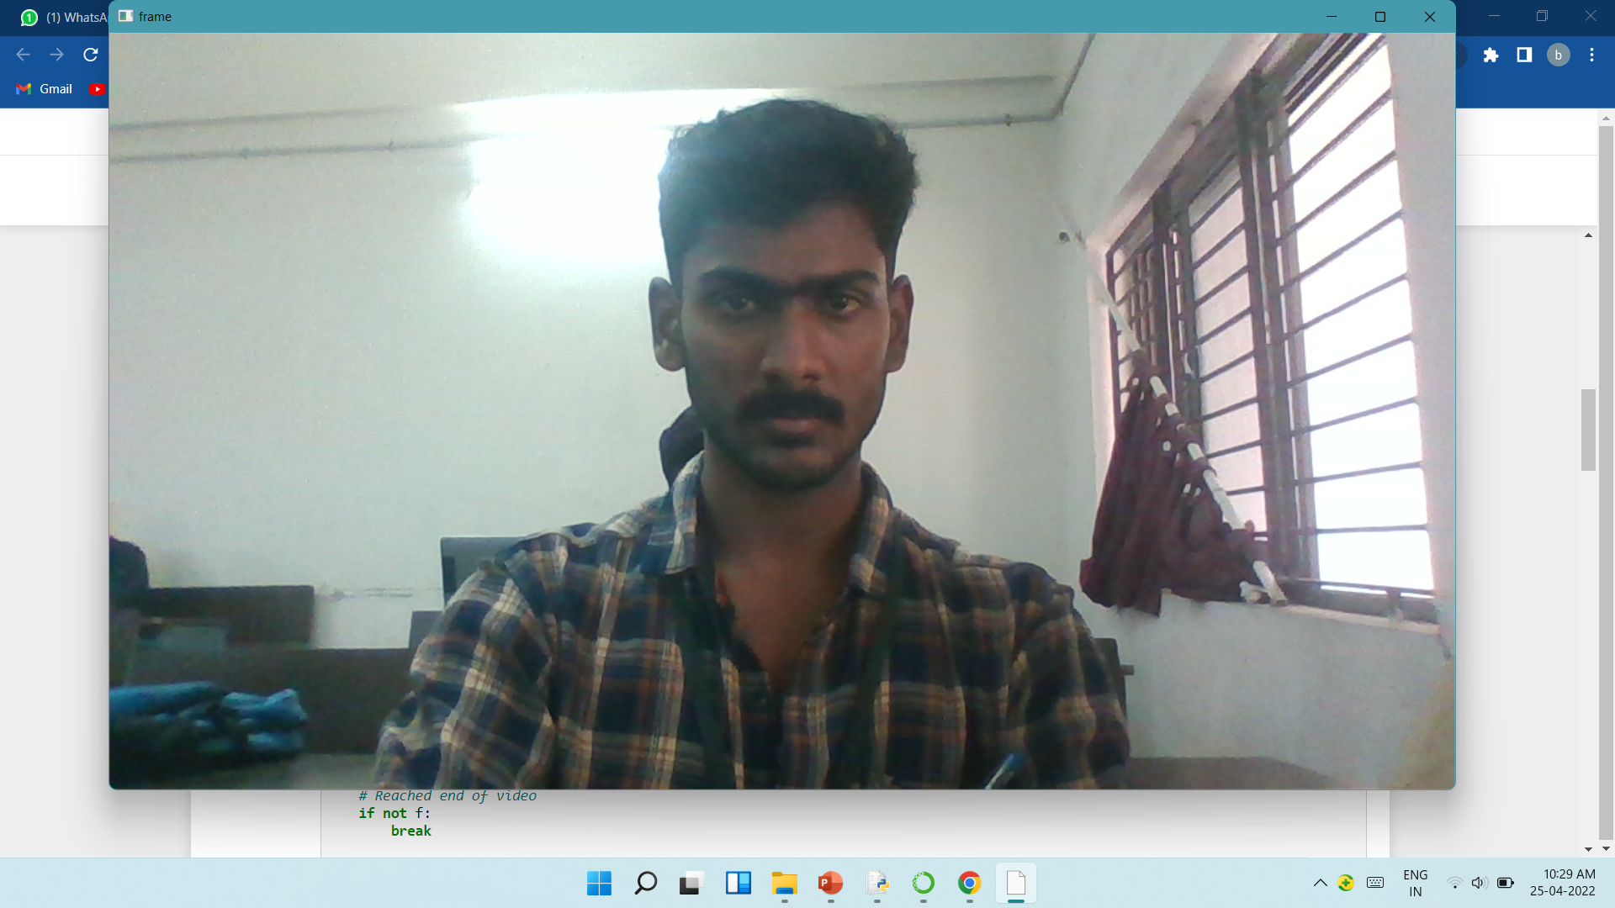
_

Slide 14
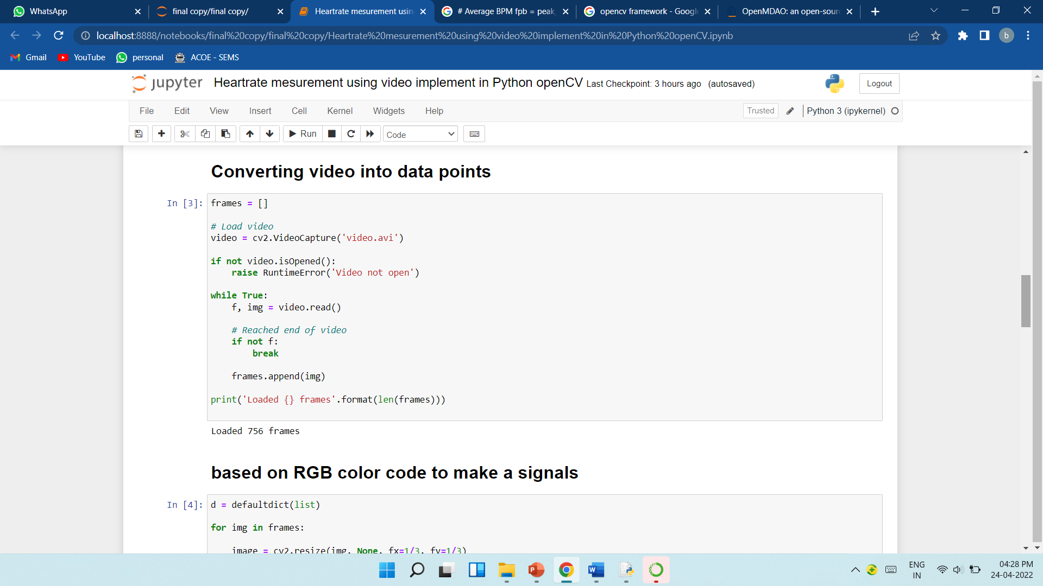
FRAME COVERSION:

Slide 15
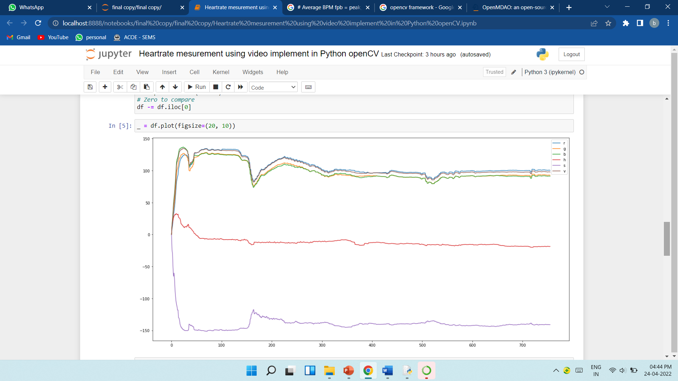
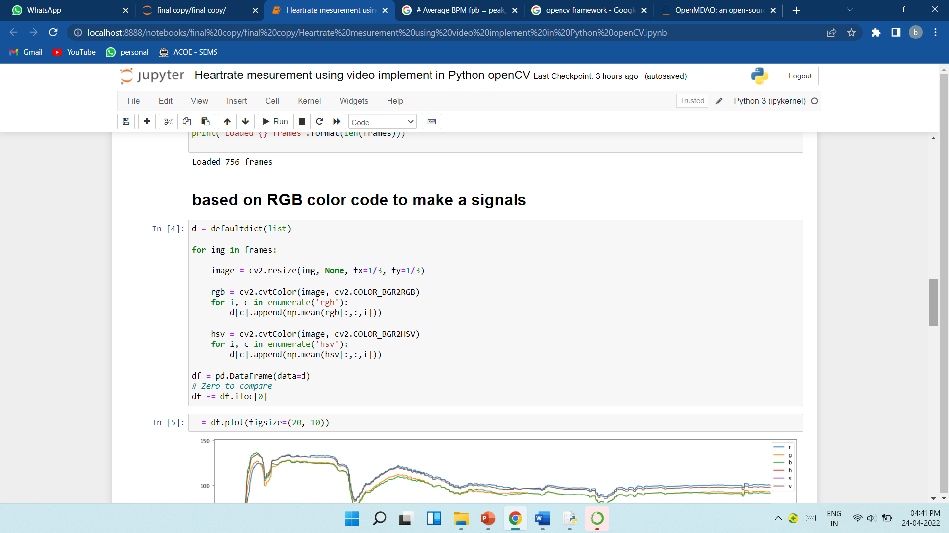
RGB & HSV SIGNALS

Slide 16
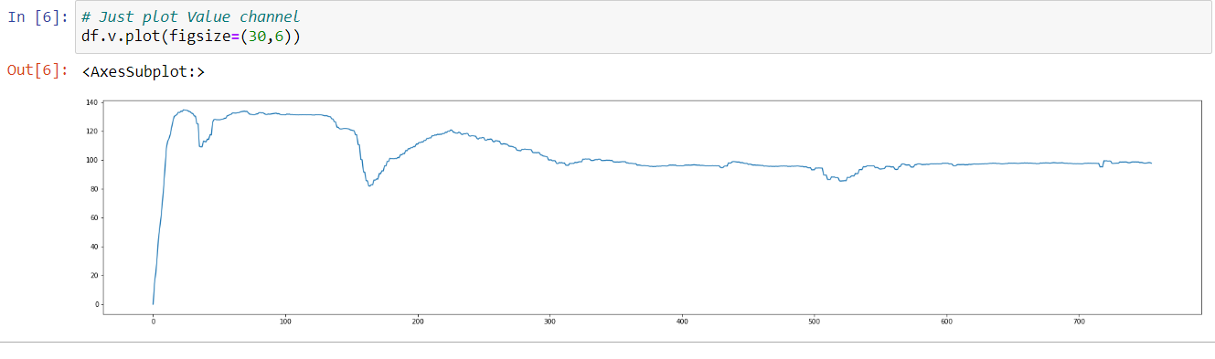
DATA PLOTTING

Slide 17
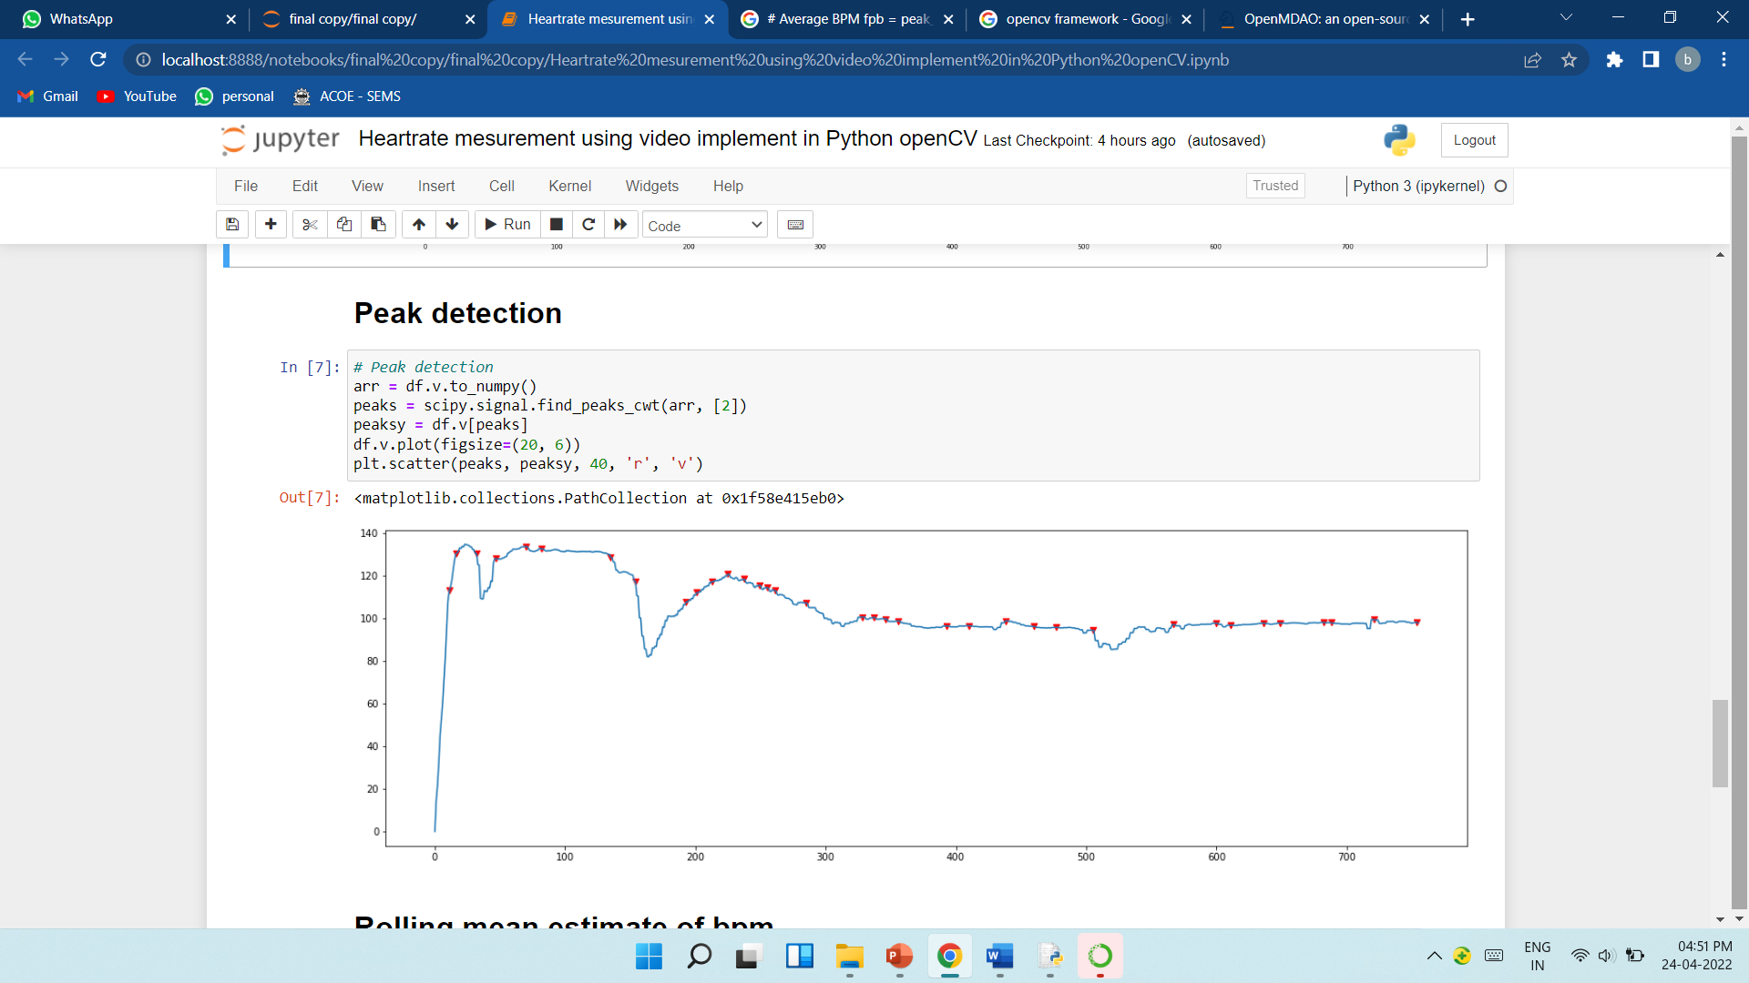
PEAK DETECTION

Slide 18
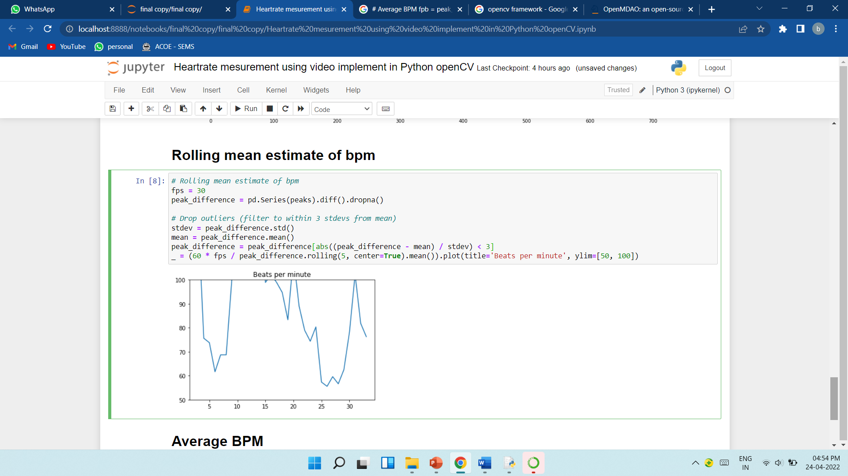
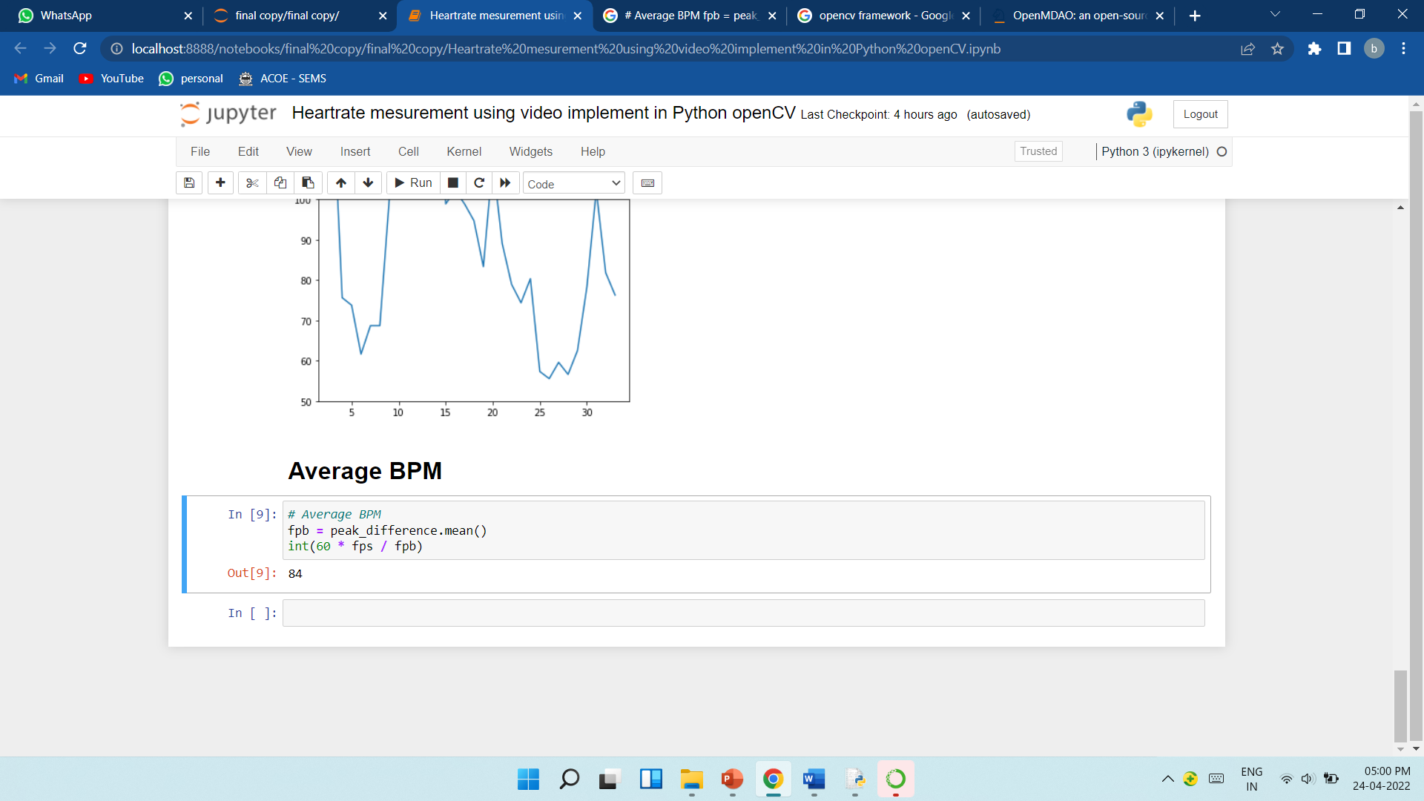
_

Slide 20
REFERENCES
https://python.hotexamples.com/examples/picamerastream/PiVideoStream/-/python-pivideostream-class-examples.html
Puneet Guptaa , Brojeshwar Bhowmick , Arpan Pal(2020). Heart Rate Monitoring from Face Video using Pulse Modeling.
https://docs.opencv.org/3.4/db/d28/tutorial_cascade_classifier.html
https://stackoverflow.com/questions/71381525/python-zooming-and-capturing-a-specific-part-of-a-webcam-live-video-using-opencv
https://www.geeksforgeeks.org/python-opencv-capture-video-from-camera/
https://www.mathworks.com/matlabcentral/answers/264007-how-to-receive-rgb-values-for-each-frame-of-the-video

Slide 21
THANK YOU

